Slide 1
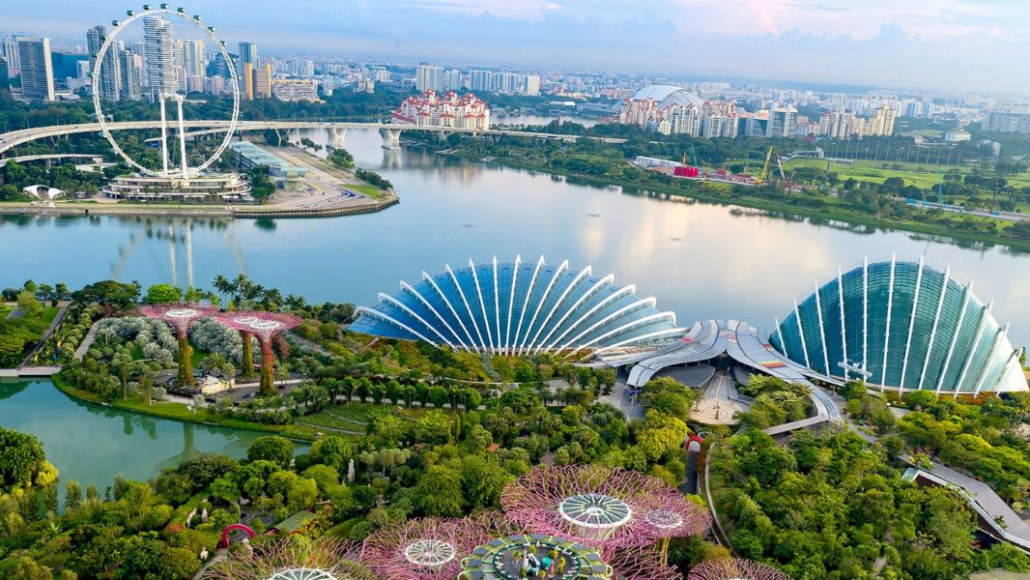

Visit Singapore

Slide 2
a

Slide 3






Slide 4
Chicken Rice
This delectable dish can be found at almost every dining spot, from humble hawker centres to high-end restaurants.
Chilli Crab
Chilli crab hits all the right spots with tangy gravy that seeps into the succulent flesh of the stir-fried crab.
Fish Head Curry
This spicy dish is a scintillating stew of curry cooked with vegetables and of course, the whole head of a fish.
Fried Carrot Cake
Contrary to its name, there's nary a tinge of orange in the local fried carrot cake, a flavourful dish that comes in the monochrome colours of black or white.
Fried Kway Teow on green plate
Fried Kway Teow
Also known as ‘char kway teow’ in Singapore, this indulgent wok-fried noodle dish has been a popular Singaporean hawker staple for decades.
Flatlay image of a plate of Hokkien Prawn Mee
Hokkien Prawn Mee
This simple dish of stir-fried noodles boasts a rich prawn stock that keeps fans coming back for more.
Flatlay image of a plate of <i>kaya</i> toast
Kaya Toast
This simple dish is the ultimate comfort food for those with a sweet tooth, offering the right mix of crunch and sugar rush.
Flat lay of a bowl of laksa with prawns, fish cake slices and garnishing
Laksa
The laksa broth offers the right balance of spice and coconut milk, a distinctive noodle soup that will tickle the tastebuds.
Top view of a plate of nasi lemak
Nasi Lemak
It's the savoury and creamy rice that carries this dish, with spicy sambal to give it that extra zing.
Top view of a plate of rojak
Rojak
Dark and sticky, the salad may not look very appealing at first; but tuck into this culinary marvel and you’ll be amazed by the delicious mix of sweet and savoury.
A plate of roti prata with curry on the side
Roti Prata
This Indian specialty is pleasing to the palate and the eye. Watch the prata-maker stretch the dough by slapping and swinging it in one skilful motion.

Slide 5
My Recommendations
Our Recommendations
View of Singapore

